Slide 1
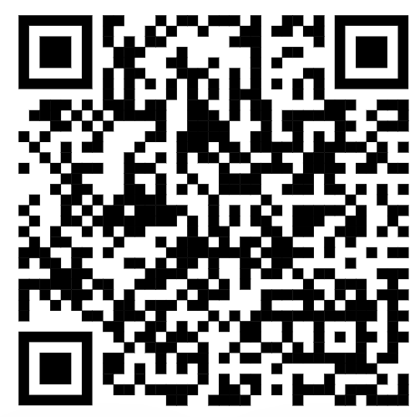
Feedback
Contact info
E-mail : bas.onokiewicz@incentro.com
Phone: +316 22529313
LinkedIn: Bas Onokiewicz
Thanks for your input these days!
Responses are not linked to person or email address:
https://forms.gle/skgrDw265qZeESFc7

